Slide 1

Meet the teacher
Year 1

Slide 2

Mrs Newman and Mrs Hunjan
Class teacher: Mrs Newman
Teaching assistant: Mrs Hunjan will support the children in the morning.
Mrs Hodges will teach every Friday morning and some Tuesday afternoons

Slide 3



Reading
Children are required to change their reading books independently. They have access to the reading book boxes in the morning and at the end of the day. They will be changed on a Monday with us.
All children will be heard by an adult at least once a week.
Parents/children are required to make entries in their reading record. These are checked by an adult at school. Three times a week entries earn a merit sticker!
All children are on reading books from our colour reading scheme.
If we feel a child is ready to move to the next colour bookband we may ask them to complete a comprehension activity.
Year One reading ‘key learning points’ state that a child must show an understanding and awareness of what they have read.

Slide 4

Spelling / Handwriting
At the front of their English homework book you will find a list of the Year 1 common exception words. Pupils are required to read and write these words by the end of year 1. The children will be tested on these words throughout the year.
Children are required to form all letters correctly. They are encouraged to focus on their pencil grip and should follow the school’s letter formation sheet.

Slide 5


Spellings

Slide 6
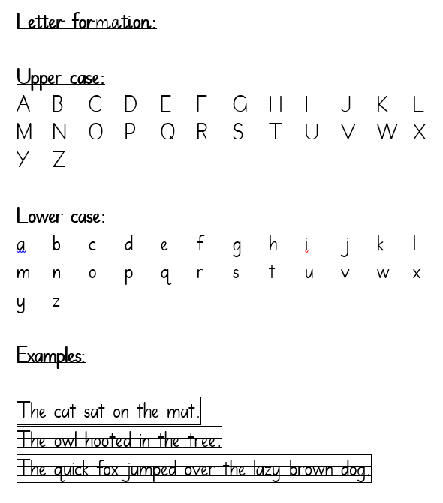

Handwriting

Slide 7

Homework
HOMEWORK WILL START THE WEEK BEGINNING 15/9/25
Children will receive two pieces of homework to complete per week.
One phonics activity in their English homework book. This will reinforce sounds covered throughout the week.
One maths worksheet in their Maths homework book. This will reinforce learning covered throughout the week.
You will also find a topic grid in their English homework book. They are welcome to complete one of these activities as an additional piece of homework.
Practice list of Year One spellings in the front of the homework book.
There will also be a phonics parents sheet related to the sound the children are learning that week posted on the class page on the website.
English homework: Handed out on Tuesday. Returned the following Monday.
Maths homework: Handed out on Thursday. Returned on Monday.
Please speak to Mrs Newman if you have any questions about homework.

Slide 8
Website
Please visit our school website for further information.
On our Year 1 class web page you will find:
Curriculum letters
Homework grids
Links to useful websites
Phonic parent help sheets
Photographs
E-safety – please refer to this for support in monitoring children's use
Our behaviour policy is on here alongside any others you may want
to see
https://www.oak-cottage.solihull.sch.uk/

Slide 9


Topics
Each half term Year 1 will cover a new theme/topic.
Autumn half term One: A Toy Story
Autumn half term Two: Magnificent Monarchs
Spring half term One: Dinosaur Detectives
Spring half term Two: Rain or shine
Summer half term One: Trees Trees Everywhere
Summer half term Two: Road Trip Rio
All information regarding individual subjects and lesson coverage can be found on the curriculum letter.

Slide 10

Lesson structure
During the morning children will complete one writing activity. We are encouraging pupils to focus on using their phonics, letter formation and sentence structure. Children also have the opportunity to complete phonic and spelling activities and guided reading.
Children will also complete one focused maths activity per day. They are encouraged to concentrate on number formation.
Afternoons consist of: phonics, History, Geography, Science, computing, PE, Art, Music, handwriting, RE and PSHE lessons.

Slide 11
Communication
Please contact the office via phone or email and I will contact you as soon as I am able.
I am happy to briefly speak at the door should you have a quick question in the morning, home time is much easier!
REMEMBER PE KITS ARE TO BE WORN ALL DAY ON A MONDAY AND TUESDAY
Only water in the water bottles please.
No earrings are allowed to be worn at any time.
No nail varnish is to be worn.

Slide 12

Volunteering
If you want to volunteer, either in the classroom or on a trip, email the office with a request.
We will have three trips – Toys (in school), All things wild and Botanical Gardens
We need help with readers.
We need help on D&T afternoons.
If you have a skill you want to utilise – tell us!
DBS – Disclosure and Barring Service
Link on school website in parents section
Your DBS needs to be kept valid by coming into school at least once every three months.

