Slide 1
Key Stage 2 Standard Assessment Tests (SATs)
11th – 14th May 2026

Slide 2
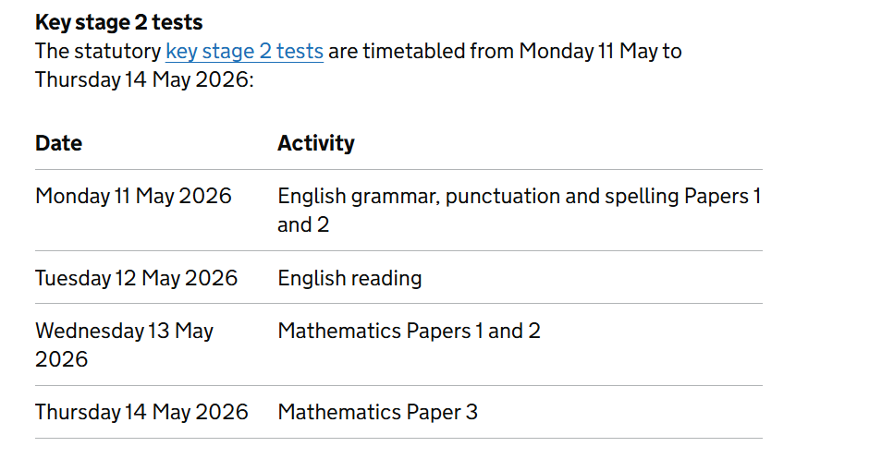
All tests are completed in the morning

Slide 3
Grammar, Punctuation and Spelling
Paper 1: questions
Time: 45 minutes
50 marks
Tests the children on the punctuation and grammar curriculum from years 3-6
  Punctuation ranges from the correct use of full stops, question marks and commas, to the more difficult aspects such as colons, semi-colons, apostrophes for contraction/omission (e.g. can’t, I’m, she’d) and singular and plural possession(e.g the cat’s whiskers vs the cats’ whiskers)
  Grammar includes:
    Knowledge and application of a range of tenses (simple past and present, past and present perfect, past and present progressive)
    Word classes (nouns, pronouns, verbs, adverbs, adjectives, determiners, etc.)
    Levels of formality/use of standard and non-standard English
    Linking clauses through subordination and co-ordination
    Different sentence types (Year 2?)

Slide 4
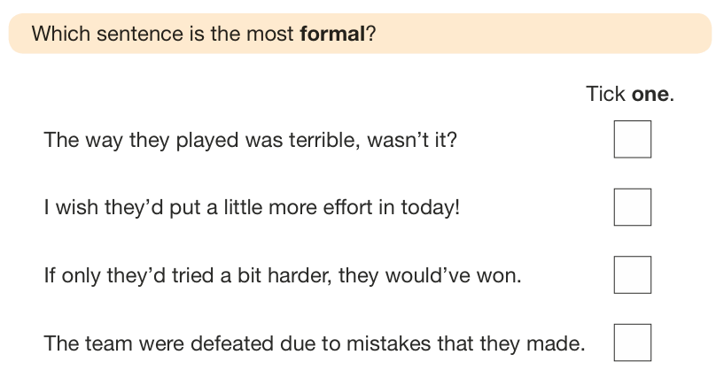
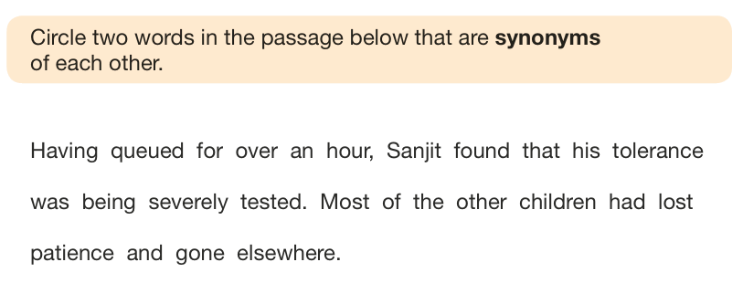
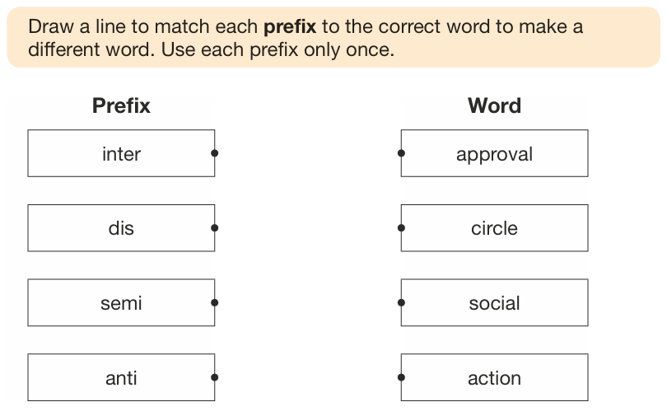
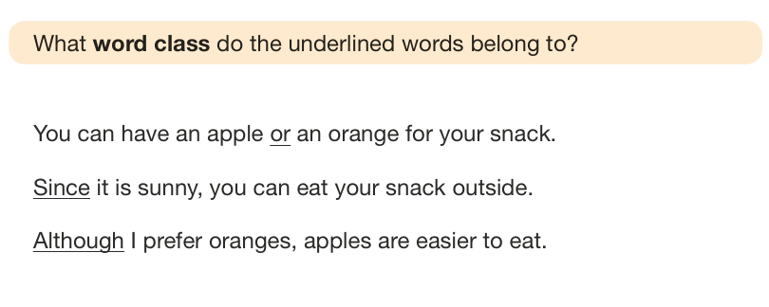
Sample questions

Slide 5
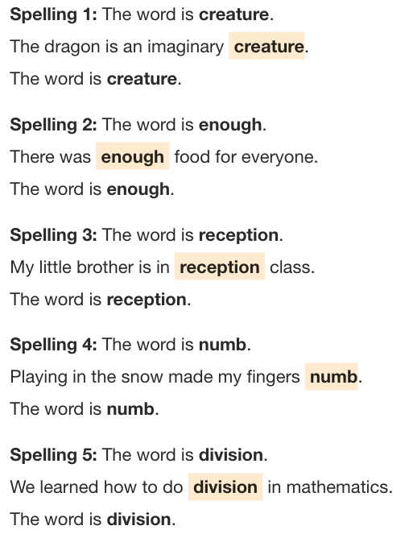
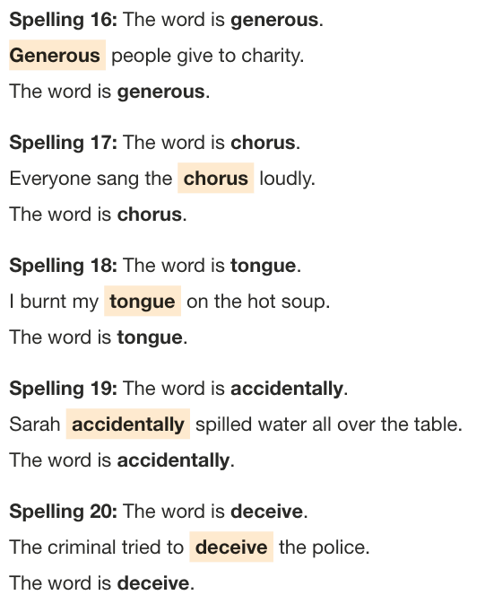
Grammar, Punctuation and Spelling
Paper 2: spellings
20 marks
Tests the children on spelling patterns from years 3-6 and some statutory spellings
20 spellings are reads to the children in a sentence
Examples:

Slide 6
Grammar, Punctuation and Spelling
Scores from both papers are combined as a mark /70
In 2025, children needed to score:
35/70 to be at the ‘expected’ standard
54/70 to be working at ‘greater depth’ within the expected standard

Slide 7
Reading
1 paper
Time: 1 hour
50 marks
Paper format:
3 extracts/texts (1500–2300 words in total)
Usually 2 fiction, 1 non-fiction

Slide 8
Content domains
give / explain the meaning of words in context
retrieve and record information / identify key details from fiction and non-fiction*
summarise main ideas from more than one paragraph
make inferences from the text / explain and justify inferences with evidence from the text*
predict what might happen from details stated and implied identify / explain how information / narrative* content is related and contributes to meaning as a whole
identify / explain how meaning is enhanced through choice of words and phrases
make comparisons within the text
*majority of the questions

Slide 9

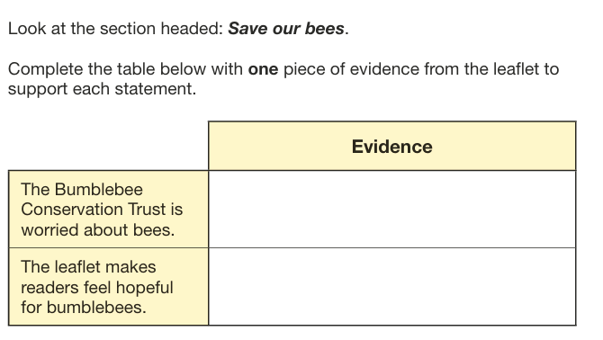

Slide 10
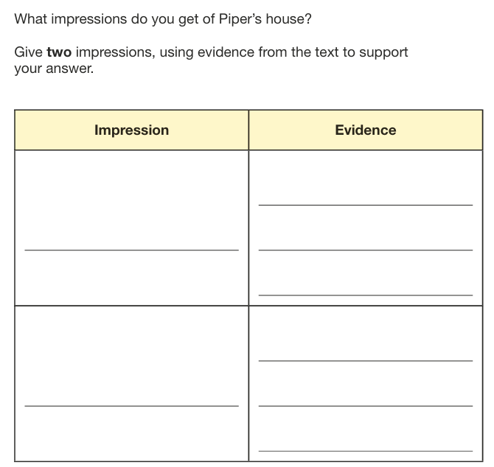
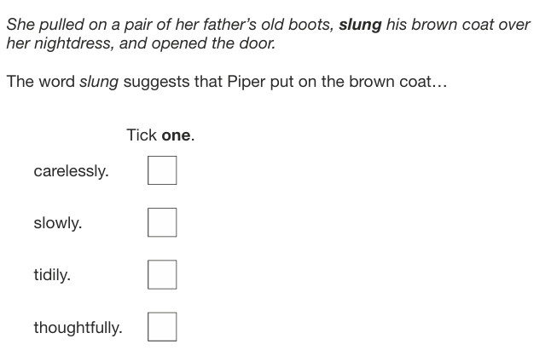

Slide 11
Reading
All 3 papers are combined for a score /50
In 2024, children needed to score:
28/50 to be at the ‘expected’ standard
40/50 to be working at ‘greater depth’ within the expected standard

Slide 12
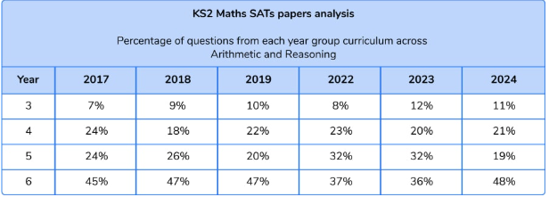
Maths
3 papers (1 arithmetic, 2 reasoning)
Tests the children on the punctuation and grammar curriculum from years 3-6

Slide 13
Paper 1: Arithmetic
Time: 30 minutes
Marks: 40
Paper 1 includes:
Addition, subtraction, multiplication and division (including long multiplication and long division)
Fractions
Decimals
Percentages

Slide 14





Some of the questions should be completed mentally, examples being:

Slide 15
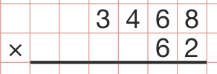

Some will require a formal written method with ACCURACY (many marks are lost with dodgy digits)!

Slide 16
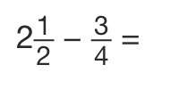
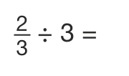






…and there are LOTS of fractions, decimals and percentages!

Slide 17
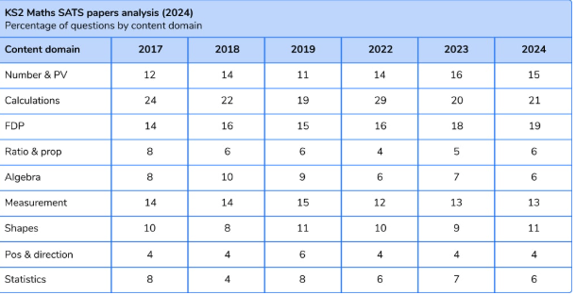
Maths
Papers 2 and 3: Reasoning (worded problems, some asking for a written explanation)
Time: 40 minutes each
Marks: 35 marks each
Questions cover the following:

Slide 18
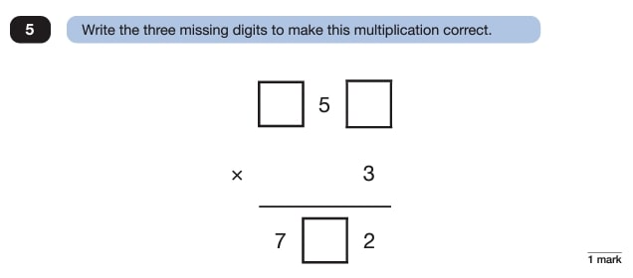
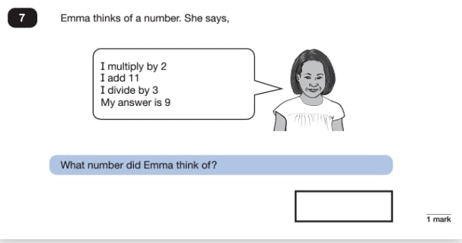
Examples:
1 mark questions

Slide 19
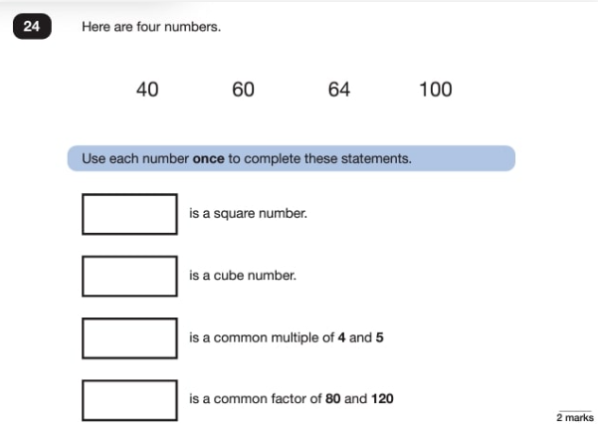
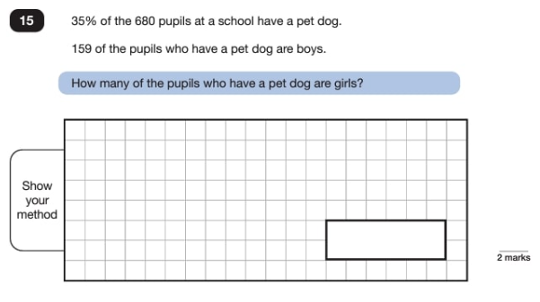
Examples:
2 mark questions

Slide 20
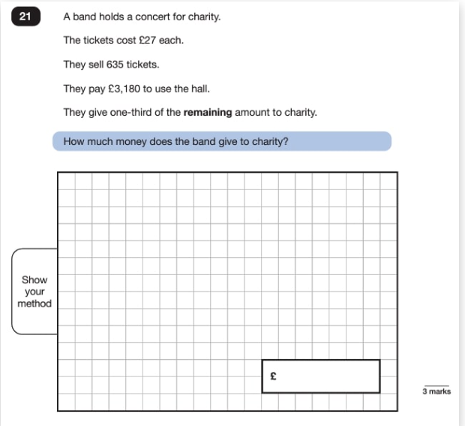
Examples:
3 mark questions

Slide 21
Maths
In 2025, children needed to score:
58/110 to be at the ‘expected’ standard (although it usually hovers just OVER half marks)
95/110 to be working at ‘greater depth’ within the expected standard

Slide 22
How can I help?
Encourage reading of quality texts
Times tables, times tables, times tables (and division facts)
CGP ‘SAT Busters’ – 10 minute tests (bundle)

