Slide 1
Meet the teacher
Welcome to year 3!

Slide 2
Staff
Miss Lennon
Mrs Kovacs – Teaching assistant
Mrs Hodges – PPA cover on a Thursday morning

Slide 3
This half term – Stone Age, Bronze age and Iron age
In topic this term we will travel through time looking at the Stone Age, Bronze Age and the Iron Age. They will explore the housing, food and clothing of the different periods and will eventually decide which age they would prefer to live in.
English: We are reading, evaluating and writing fractured fairy tales, we have started with The Princess and the Pea and started to look at different versions of the story.
Maths: Place value and addition and subtraction.
Times table focus in year 3 – must know their 3s, 4s, and 8s before year 4.

Slide 4
Topics to come
Autumn 2: Raging Rivers
Spring 1: Changing children
Spring 2: Antarctica
Summer 1: I am a Greek– Greek day/fancy dress
Summer 2: Rainforests

Slide 5
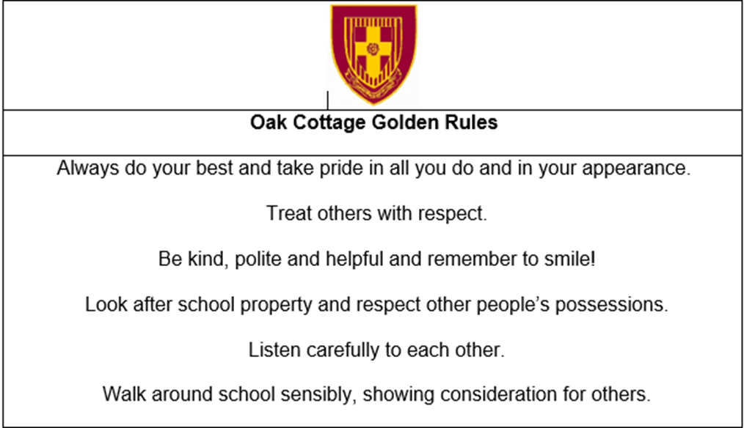
Behaviour and expectations

Slide 6
Rewards
Class points- each child has a class point chart where they need 40 class points to get a certificate, they then move to the next colour chart.

Slide 7
Expectations
No earrings in school
Bracelets
Come to school in PE kits on a Monday
Swimming kit on a Tuesday

Slide 8
Equipment

Slide 9
Swimming
I will need two parent helpers each week, if you are available please sign up with me or Mrs Harris – your help is much appreciated!
Swimming kit on a Tuesday (Please can everything be labelled)
Swimming cap
Swimming shorts (Not long)
Costume (girls)
Towel
Swimming goggles (optional)
Healthy snack for after
Swimming groups are chosen by Tudor Grange teachers
Changing rooms

Slide 10
Homework
English homework will be set on a Monday and completed for the following Monday. This will include either a grammar and punctuation worksheet or a reading comprehension.
The grid linked to topic stuck in their English homework books is optional on website.
Spellings/ handwriting sheets will be given on a Monday and will be tested on a Monday Morning. Please support them with learning these spellings.
Maths homework will be set on a Wednesday and completed for the following Wednesday. This will be a piece of work that will link to the previous weeks learning.
Reading: Children should read 4 times at home these should be logged in their reading diary. Please encourage reading at home.

Slide 11
Things to do at home
Times tables 3, 4 and 8 times tables.
Challenge with the 6 times tables.
TT Rockstars is available to them
Reading- reading comprehension

Slide 12
E-safety
Please keep an eye on what children are doing online.
Age limits
Talking to people

Slide 13
Contact
Email: 42office@oakcottage.solihull.sch.uk
In person: 8.50/3.30

Slide 14
Young voices log in
If you are struggling to create an account please see me and I will set you up
https://url.uk.m.mimecastprotect.com/s/jTXMClRp1iAqyJ5FGf3izjPJF?domain=yvmusicroom.com

Slide 15
Thank you for attending
Any questions?

