Slide 1
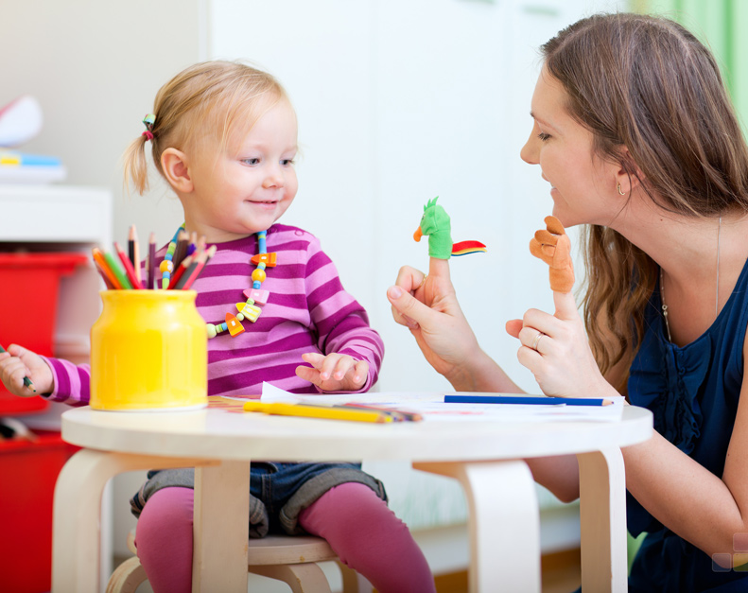
Speaking and listening parent workshop
Mrs Dennis
Miss Ashington

Slide 2
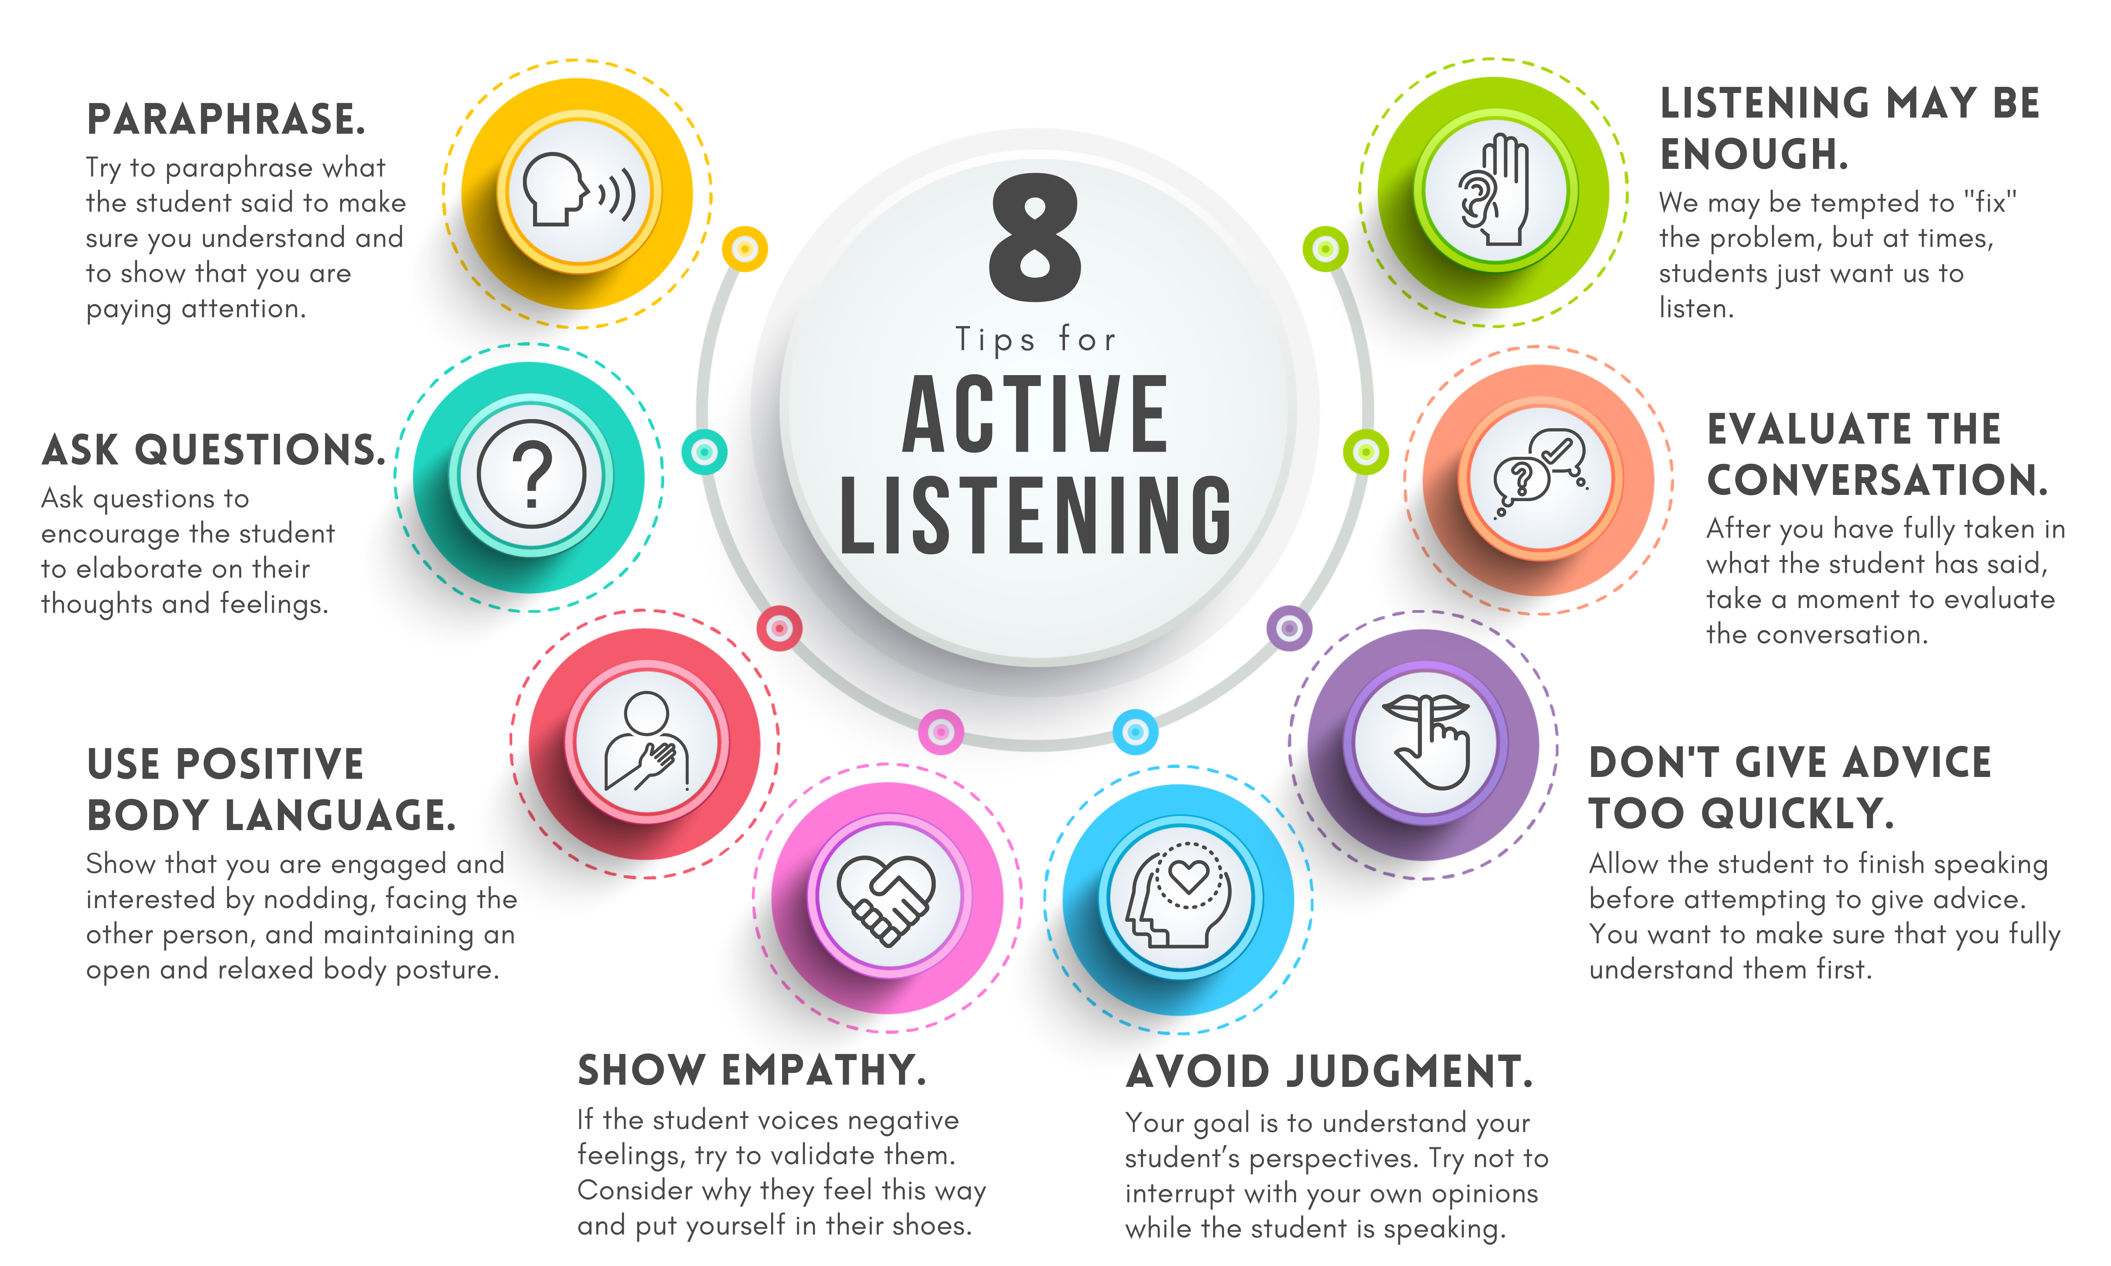
Strategies to support:
Pronunciation, modelling and phonics
Interactive videos and games
Family times & verbal communication
Screen time

Slide 3

Statistics
There are now 1.9 million children with speech and language challenges in the UK, an increase from 1.5 million just 2 years ago
Education: Poor vocabulary at age five makes children more than twice as likely to be unemployed at 35 and significantly increases the risk of falling behind in literacy and maths by age 11.
Attendance: Children with S&L challenges are at higher risk of school absence.
First Language Impact: In 2022/23, 71% of children with English as their first language met the standard, compared to 63.4% for others.
Gender Gap: In 2022/23, 75.6% of girls reached expected language levels, versus only 62.3% of boys.
Most Common SEN: S&L Needs are the primary need for about one in four pupils with Special Educational Needs (SEN) support.
Age 4: By the age of 4, children should be able to speak around 1500 words with at least 4 to 6 words in every sentence.
Age 5: By the age of 5, children should be able to speak around 2500 words with more than 6 words in a sentence.

Slide 4
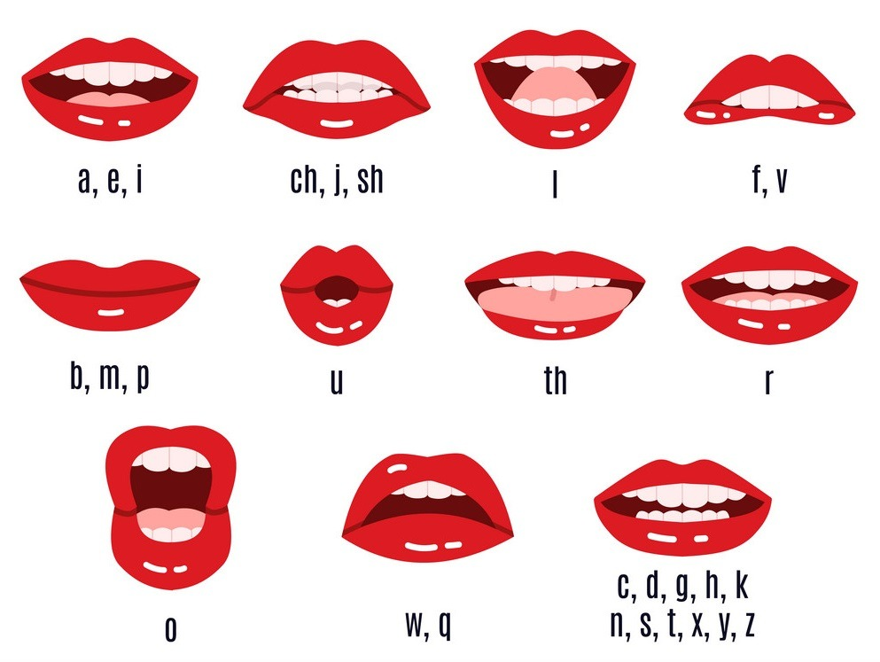
Pronunciation, modelling and phonics
Research shows that bilingual children who have a secure understanding of both languages often achieve higher levels of success in education compared to monolingual peers, as their cognitive flexibility and problem-solving skills are enhanced.
Assessment is in English.
Modelling vocabulary and speaking in sentences. – Regional accents (Oxford English vs social English), speaking links to writing e.g. cuz, gna, fink, can I go toilet?
Video: Talk to each other when you're out and about
https://www.nhs.uk/best-start-in-life/toddler/learning-to-talk/learning-conversations-and-telling-stories-3-to-5-years/#video-talk-to-each-other-when-out-and-about
Phonics – Lessons support listening, pronunciation, reading and writing – sounds support spelling e.g. names and sounds

Slide 5















Revisit and Review
Let’s practise Sam’s Sounds and Tricky Words!
v
j
y
x
qu
ch
w
z
zz
ng
th
th
sh
igh
oo
oa
ai
ee
oo
my
was
be
me
she
we
he

Slide 6





Teach
Kit, Sam, Mum and Dad were camping in the woods. After a lovely day playing, it was beginning to get dark.

Slide 7


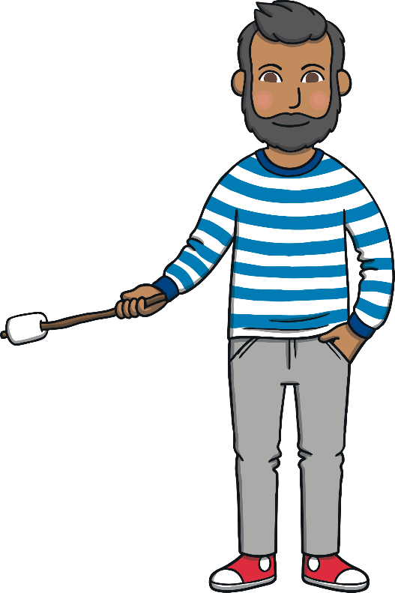

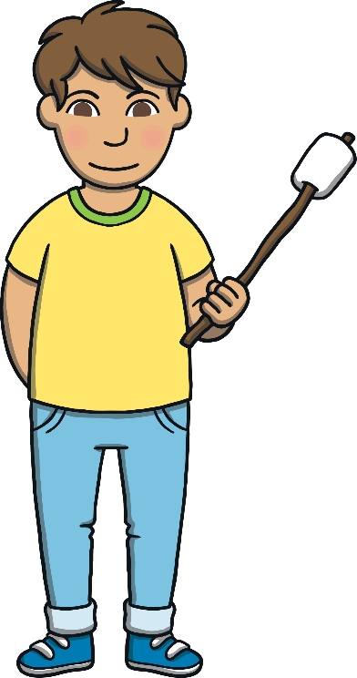

Teach
“Let’s light a campfire tonight,” said Dad. The family collected some sticks and Dad lit a fire. They had toasted marshmallows and looked up at the twinkling stars.

Slide 8




Teach
Mum pointed up into the night sky. “See that bright star?” she said to the children. “It’s called the North Star.”
“Ahh,” said the children, looking up in amazement.

Slide 9



a
r
Teach
a and r are partners. They say ar.

Slide 10


Action
Teach
Teach
Make twinkly star fingers.
Say ‘ar’.

Slide 11




Write It, Feel It
Teach
ar
Around the apple, up the stalk and down the leaf.
Down the robot's body, up and over its arm.
Play

Slide 12



Practise
jar
Show

Slide 13

Practise
car
Show

Slide 14

Practise
card
Show

Slide 15
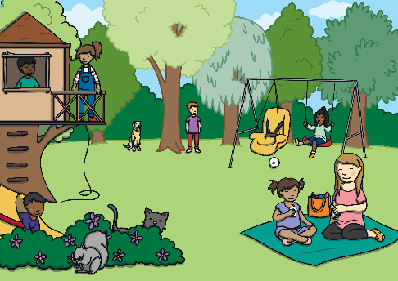


Apply
Can we go to this park?
Show

Slide 16
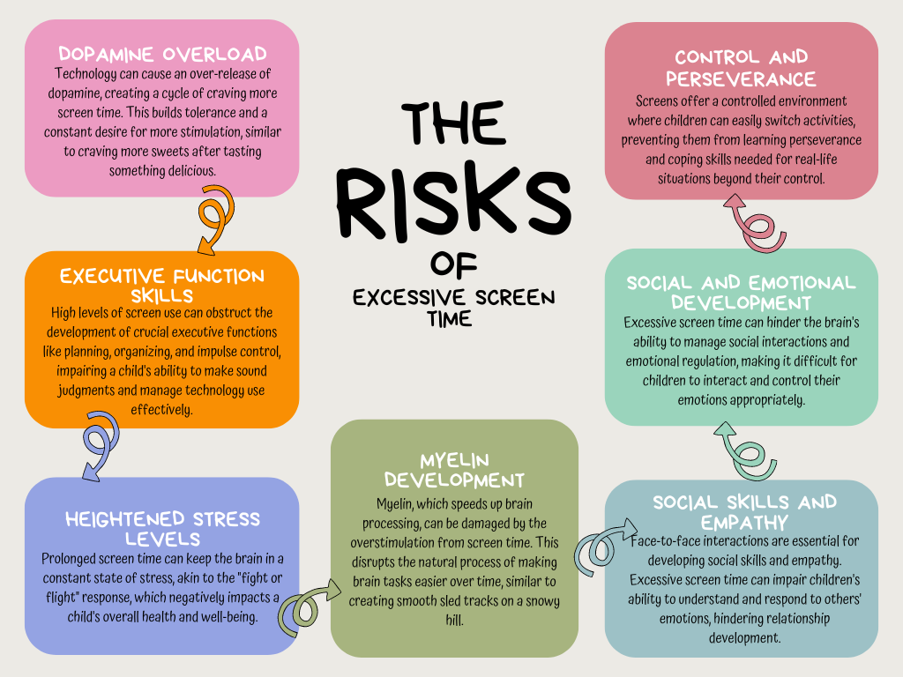
Interactive videos and games
What children watch can massively affect their education, positively and negatively.
Americanisms
Accuracy of media e.g.
Media can be supportive with learning when monitored.
Screen time
https://www.youtube.com/watch?v=GGBgf8dcgyY
Device Ownership: Over half (58%) of children have their own tablet by age four
Excessive screen time in this age group is linked to issues like reduced core strength, potential for anger/frustration, lack of patience when devices are removed, poorer sleep and higher BMI.
Sleep routine
Imagination is shrinking and attention is thinning.
Neuroscience shows that screen hit the reward system hard. Dopamine spikes during fact paced digital play are up to 400% higher than during imaginative play. This rewires what the brain finds exciting and therefore real life starts to feel slow.
Children are losing the ability to tolerate boredom.
Tablets keep children quiet but they also keep children distant.
Core body strength is reduced due to body position during screen time
No more than one hour per day co-viewing with a parent or sibling.

Slide 17
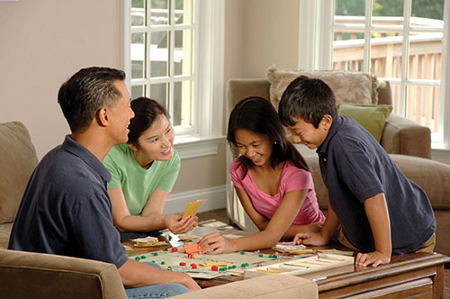
Family times & verbal communication
Importance of conversation – car journeys, walks to park, meal-times, collecting from school.
No quizzing – conversations can happen more easily when not asking lots of questions eg bathtime, reading books, singing
Verbal communication – social cues/phones/modelling
Background noise – easy to keep technology on which stops conversations
Sharing stories increases a child's vocabulary – 5minutes a day
Video: Sounds, rhymes and words wherever you are
Phonics play: How rhymes can help children's understanding of language - BBC Tiny Happy People

Slide 19
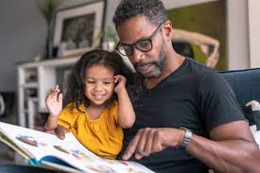
How to help at home
Give plenty of time for a child to initiate or respond (observe, wait and listen)
Use simple sentences that are around one word longer than the child is saying
Copy what your child is doing or saying. Build on it by adding one or two words to
their sentence, for example ‘car’ ‘yes, a red car’
Don’t ask too many questions, use encouraging comments or open questions, like
‘you like that‘ or ‘tell me about your day’
Give alternative words with the same meaning e.g. big, large, massive
Make time for communication every day – have a quiet time in the day where
distractions are minimised
Get their full attention when you are talking to them
Use everyday routines and activities to practise communication skills, times like bath
time and mealtimes are great.
Keep screen time to a minimum.
Share a story every day
Handouts

Slide 20

Benefits of Developed Speech and Language Skills
Useful websites:
https://speechandlanguage.org.uk/about-us/news-and-blogs/screen-time/
https://speechandlanguage.org.uk/educators-and-professionals/ages-and-stages/3-4-years/
https://speechandlanguage.org.uk/educators-and-professionals/ages-and-stages/4-5-years/
https://www.nhs.uk/best-start-in-life/toddler/learning-to-talk/learning-conversations-and-telling-stories-3-to-5-years/#video-talk-to-each-other-when-out-and-about
https://www.nhs.uk/best-start-in-life/toddler/learning-to-talk/learning-conversations-and-telling-stories-3-to-5-years/#Activities
Strong speech and language skills are fundamental to overall development and life outcomes.
Educational Attainment: Children with good language skills at age 5 are significantly more likely to reach the expected standard in English at the end of primary school than those who struggled.
Social and Emotional Well-being: The ability to express thoughts, ideas, and feelings clearly is linked to improved self-esteem, better relationships, and enhanced quality of life.
School Readiness: Strong early language skills are essential for children's readiness for school, enabling them to achieve their potential and improving their life chances.

