Slide 1


Slide 2
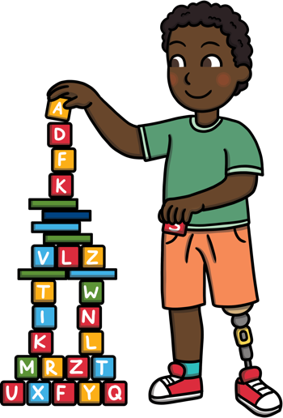
Introduction
(
This presentation aims to give an introduction to the changes in the Early Years Foundation Stage (EYFS). It includes information which we hope you will find useful, whether you are a new parent to the EYFS or a parent who is more familiar with the previous EYFS.

Slide 3
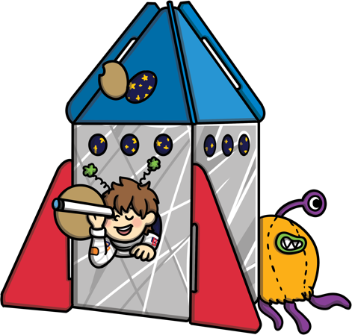
What Is the EYFS?
The Early Years Foundation Stage covers the first stage of a child’s care
from birth to five years old. It sets the standards to ensure that all children
learn and develop, as well as keeping them healthy and safe.
All schools and Ofsted registered early years providers in England must
follow the EYFS.
Also included in the EYFS are the seven Areas of Learning. They are:
  Communication and Language
  Personal, Social and Emotional Development
  Physical Development
  Literacy
  Mathematics
  Understanding the World
  Expressive Arts and Design
At the end of the EYFS, there are 17 Early Learning Goals that children are expected to achieve.

Slide 4
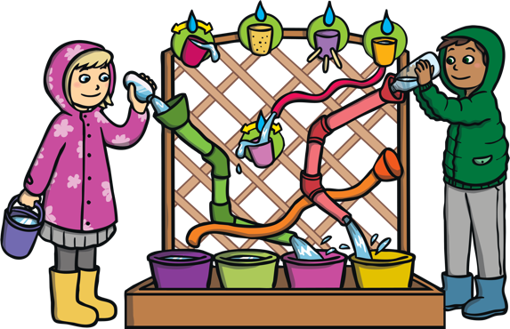
Why Have the Changes Been Made?
In 2019, the government proposed changes to the EYFS. These changes have now been made and all early years settings and schools will follow the new EYFS from September 2021.
The aim of the changes is to improve the learning for all children and better prepare them for the move into year 1.
To help make the right changes, evidence was looked at to find the best ways children can be supported in developing as they grow.
The changes also hope to give children the best start in life and set them up well for their future.
Not all parts of the EYFS have changed, some elements have remained the same or similar.

Slide 5
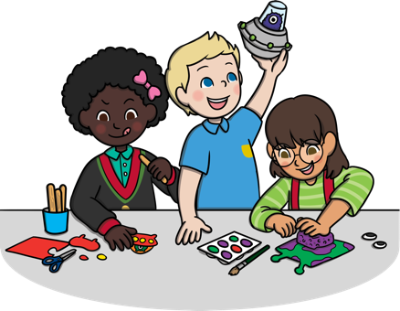
Some Key Changes
Reduced the amount of unneeded written recordings and assessment of children by staff.
This means staff do not need to keep a large amount of written evidence that proves children are able to do lots of things.
Staff still know the abilities and skills of each child, and know how to support them to develop. However, now they do not need to write this down unnecessarily.
This frees up more time for staff to spend directly with the children.
By taking away the need for constant recording, it helps to develop more natural play, conversations and interaction between adults
and children.

Slide 6
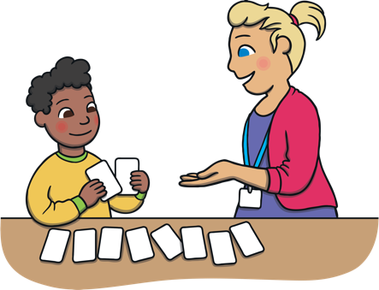
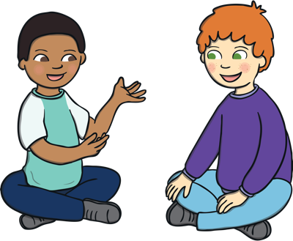
Some Key Changes
There is more of an emphasis on the importance of developing communication and language skills.
Children should be supported in building up vocabulary by increasing the amount of words they know and can use.
Encourage more conversations between adults and children, but also children and their peers.
Good language skills are the basis for all other learning and social interaction, so this is vital to focus on.
(

Slide 7
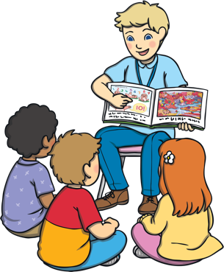
Some Key Changes
There is a focus on how reading stories is important to help children develop in all of Areas of Learning.
Daily reading of stories encourages an enjoyment of reading from a young age.
Lots of other learning opportunities happen when looking at books, for example comparisons of culture or the past.
Listening to stories develops imagination, ideas and language.
Reading is an essential skill and so should be shown to children, as well as practised by them regularly.
Children are also encouraged to use story ideas in their play.

Slide 8
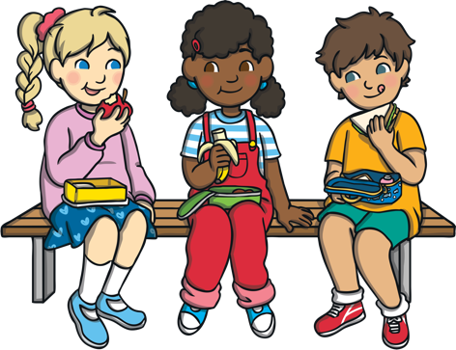

Some Key Changes
There is a focus on encouraging healthy choices overall and an understanding of oral health.
Required to teach children the importance of brushing teeth.
Supervised toothbrushing is not expected in settings and schools.
Focus on helping children to understand which choices to make that will help them to be healthy, for example which foods to eat and why.
Getting into good routines from a young age is important as these often continue into adult life.

Slide 9
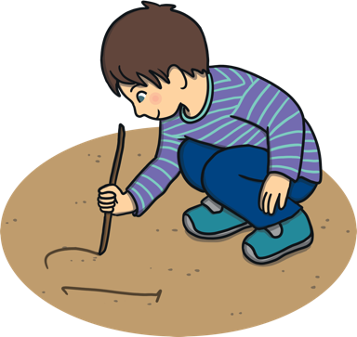
Changes to Informal Assessments
There have also been changes to a document called ‘Development Matters’.
This document is not compulsory but it can be used by staff to support them to understand child development in the different Areas of Learning.
Linked to this document change, children are no longer assessed against an age band. It’s now accepted each child develops in different ways, so the use of the age bands before did not fit everyone fairly.
Staff can now use their own knowledge of child development to decide each child’s next steps and support needs.
These changes allow more freedom for
adults to plan to the learning and interests
of the children in their class.

Slide 10
Overview of Changes to the Early Learning Goals
At the end of the reception year, children are assessed against the 17 Early Learning Goals.
It is important to remember that:
  The ELGs are not a test. Staff will use what they already know about a child to make their decisions.
  The ELGs are not the EYFS curriculum. They should not be used to be taught to, they are just an end point.
Changes have been made to the Early Learning Goals so that they are now clearer, easier to use and understand.
They have also been adapted to better match up with the national curriculum in year 1. This will help children to be better prepared for their move to the next key stage.
Exceeding judgements have also been removed. Children are now encouraged and challenged to have a greater depth and understanding of things before moving onto new learning.

Slide 11
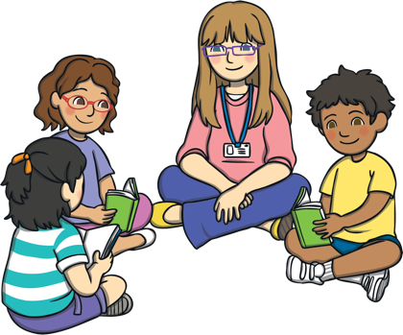
Summary
We hope that you have a better understanding of the changes that have been made to the Early Years Foundation Stage.
We also hope you feel reassured that the wellbeing and care of the children is still the main priority of the EYFS.
Young children are still encouraged to learn and develop through play and exploration. The adults support this through guidance and teaching of skills.
Should you have any further questions on the EYFS changes, staff will be happy to discuss these with you.

