Slide 1








Introducing your Solar MHST
Notes:
This morning is for you – we have a presentation that explains who Solar are, the MHST offer and a brief touch on mental health. We also have time for questions. However, if you would just like to have a conversation over coffee, we’re happy to do that too.

Slide 2

Your Solar MHST
Solar is a partnership between Birmingham and Solihull Mental Health NHS Foundation Trust (BSMHFT), Barnardo’s (the charity) and Autism West Midlands. This means we work as part of the Children’s and Adolescent Mental Health Service (CAMHS).
We work with children, young people (CYP) and families in Solihull aged 0-19 who are experiencing mental health or emotional wellbeing difficulties.
We deliver mental health interventionsfor mild to moderate mental health issues (this could be 1:1 if referred to Solar)
To support your mental health lead and school staff to develop their whole-school approach and promote mental health and wellbeing.
To help children and young people (CYP) get the right support and stay in education.

Slide 3
The Support We Offer
1:1 Sessions (if referred into our service)
Parenting Workshops
Assemblies
PHSE Lessons
Staff Training
Small group workshops for young people (i.e., anxiety, low mood, anger, emotions, sleep)
Audit of whole-school approach to wellbeing.

Slide 4
What is Mental Health?
“…a state of well-being in which every individual realises his or her own potential, can cope with the normal stresses of life, can work productively and fruitfully and is able to make a contribution to her or his community.” (WHO)
“Mental health influences how we think and feel about ourselves and others and how we interpret events. It affects our capacity to learn, to communicate, and to form, sustain and end relationships. It also influences our ability to cope with change, transition and life events: having a baby, moving house experiencing bereavement.” (Scottish Executive, 2004).

Slide 5
Common Mental Health Struggles in Children
Worry/Anxiety
Low Mood
Emotional Regulation
Notes:
Experiencing these different things are completely normal.
You should begin considering seeking support if you notice this is having an impact on your child’s day to day life

Slide 6
Protective & Risk Factors
Protective
Good relationships with family
Good relationships with friends
Supportive school
Resilience
Interests/hobbies
Healthy diet
Good sleep
Risk
Bullying
Friendship issues
Family history of mental health
Changes
Poor family relationships
Problems within school
Illness
Neurodiversity
Bereavement

Slide 7
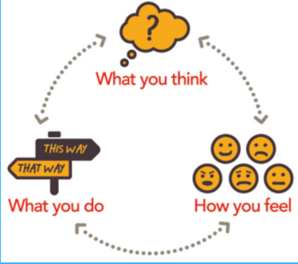
Signs to Look Out For
Notes:
These are some key things to look out for –
Thoughts:
Is your child questioning friendships
Is your child questioning their ability in school
Behaviours:
Have there been any changes in your child’s typical behaviours e.g. always go to Beavers but now saying they don’t want to go, spending more time in their room, saying they don’t want to go to school
Changes in sleep/eating
Crying a lot more than usual
Bodily Sensations:
Complaining of stomach aches/head aches
Shaking
Fidgeting
Going to the toilet more regularly
Feelings:
Scared, sad, nervous, worried etc
Getting angrier, more irritable
Unable to share how they’re feeling

Slide 8
Coping Strategies & Ways to Improve Mental Health
Grounding
Breathing
Worry Management
Getting outside
Doing things we enjoy
Healthy Diet
Good Sleep Routine

Slide 9
Making Referrals
We accept self, GP & School referrals – referral forms can be found on our website
Add as much detail as possible – this helps us to have a better understanding
We DO NOT offer assessments for ADHD/Autism
Once a referral has been received, it goes through a screening process
If accepted, an assessment will be offered
The assessment gathers information on presenting concerns, social circumstances, developmental history, pregnancy/birth, family history of MH and a full risk assessment (checking risk of harm to self, from others and to others)

Slide 10
Time for Questions

