Slide 1
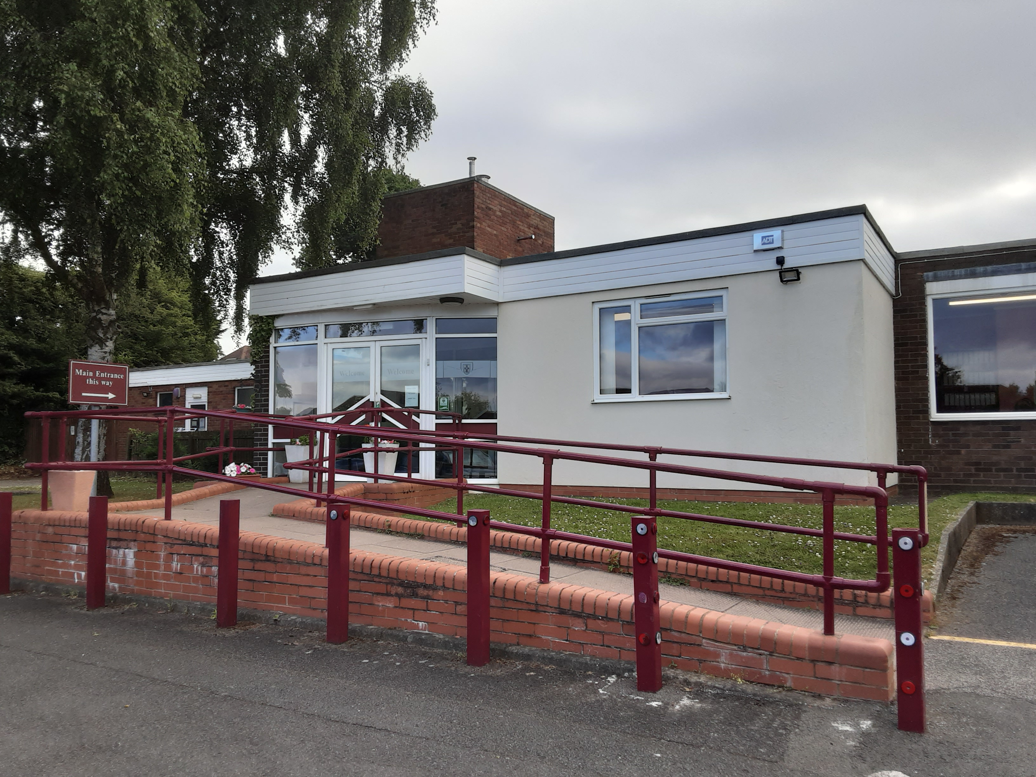

Oak Cottage School
End of Year 1 Impact Report
Date: 01.12.2025
Notes:
Image to be replaced with one of the school if you have a high enough quality image or a standard LGZ image

Slide 2
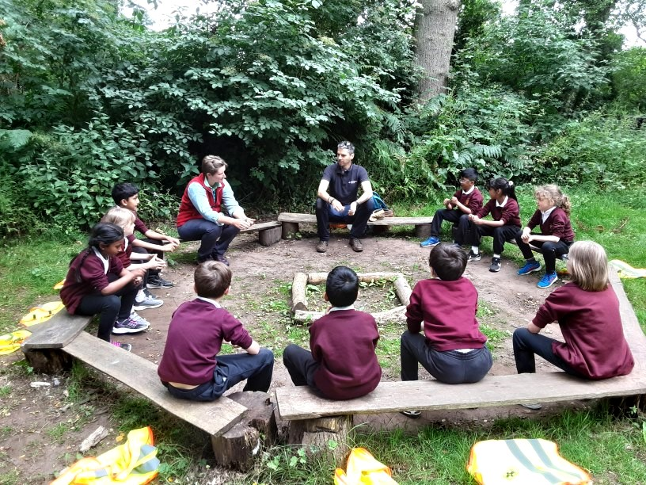

This report covers:
A comparison of your Baseline and End of Year 1 Carbon footprints
Your completed Year 1 actions & those to keep/ embed in Year 2
Some remaining incomplete actions from Year 1 to consider
New suggested actions to raise ambition in Year 2
Our ongoing support
www.letsgozero.org
charity no: 1104153
Notes:
Image to be replaced with one of the school if you have a high enough quality image or a standard LGZ image

Slide 3

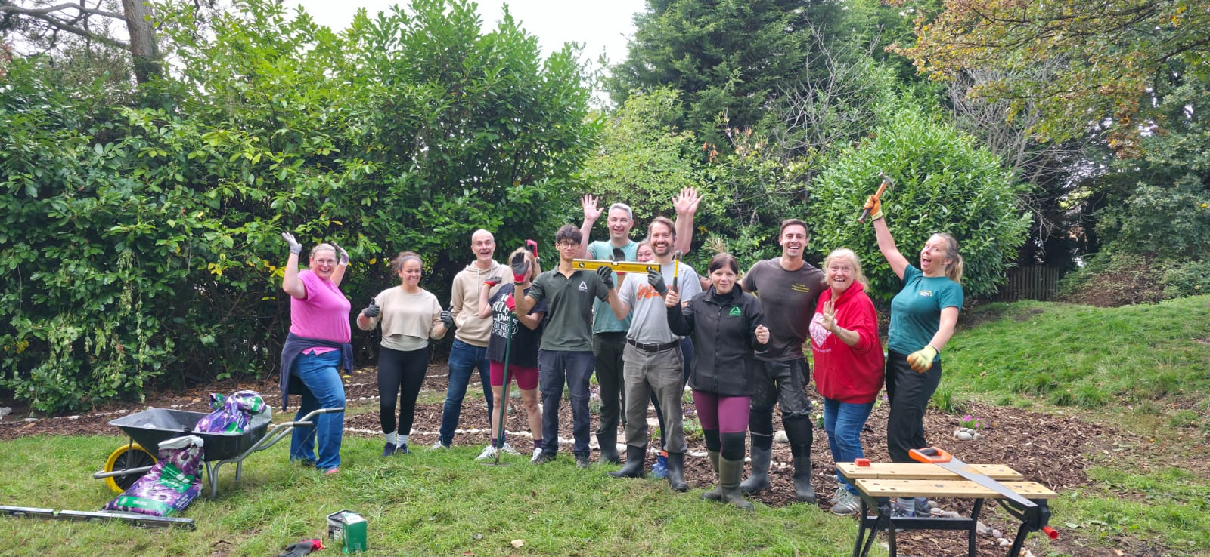



What a great year...
Energy: By monitoring student energy through your West Mercia platform, you have successfully promoted better behaviour throughout the school.
Nature: Your school successfully applied for a £5,000 Npower grant to enhance the nature area. Groundworks helped create a space with plants to attract pond wildlife, a new stone path with shrubs, and exciting additions like birdhouses, a mini-beast hotel, and a composting area.
Waste: Your school has been certified as a Plastic Free School after eliminating cling film and switching to beeswax wraps and reusable Tupperware. Students have also written to Parliament to support environmental action.
Culture: The school has an eco-section on its website, updated regularly. A new eco team has been elected, complete with badges and a calendar of events, including litter picking. The school has achieved Greener Schools Award Levels 1, 2, and 3 and Level 4 which requires a CAP.
Notes:
CAA can change the number of examples, plus the icon (click “insert” on toolbar, then icons, then type a suitable search term e.g. food)

Slide 4

Baseline year 1: Date
Your school's total carbon footprint was estimated to be: 168.07 tonnes CO2e per year
End of year 1: Date
Your school's total carbon footprint was estimated to be: 121.92 tonnes CO2e per year
 |  | Total Emissions tCO2e
 |  | Baseline | End of Year 1 | % Change to Baseline
 | TOTAL EMISSIONS CO2e: | 168.97 | 121.92 | -28%
Energy and Utilities | Fuel Usage | 27.04 | 13.40 | -50%
 | Electricity Usage | 13.52 | 11.10 | -18%
 | Waste Usage | 0.00 | 0.01 | 1%
 | Water Usage | 0.00 | 0.03 | 3%
Transport | Vehicles | 0.00 | 0.00 | 0%
 | School Trips | 0.00 | 0.09 | 9%
 | Student Commutes | 5.07 | 10.30 | 103%
 | Staff Commutes | 11.83 | 7.60 | -36%
Food | Meals | 27.04 | 62.50 | 131%
Purchases | Spending | 25.35 | 15.90 | -37%
 | Uniforms | 57.45 | 13.10 | -77%

Slide 5


How your two calculations compare
Student commutes: since your baseline calculation, the tool has been improved, now asking for the typical commute distance rather than the furthest. This explains some of the changes in emissions shown here.
Whilst your staff travel habits have not changed, the tool now asks for an average staff commute distance, which for your school is a 3.3 miles - the tool has been corrected to show a more accurate estimate of your staff travel emissions.
Key
CO2e reduction due to the school’s action
CO2e change due to other factors

Slide 6




Your completed Year 1 actions and actions we suggest you embed in year 2
Sign up to the Let’s Go Zero campaign
Add sustainability goals/ projects/ successes to school website
Set up a sustainability working group
Complete a Count Your Carbon calculation
Monitor energy use on a regular basis through dedicated platforms
Take part in a switch off campaign
Check that your solar panels work
Weigh food waste from kitchen and plates, share results, and set a target to reduce this
Explain reasons for eating less meat and reducing food waste during lessons, assemblies etc.
Contact your waste collectors to organise food waste disposal and diversion to AD
Access the Climate Ambassadors scheme
Establish a gardening/nature club
Follow sustainable practices when choosing products
Conduct a staff and student travel survey
Gained an accredited active travel plan
Provide students with education on the importance of reducing, reusing and recycling correctly
Participated in various waste schemes to include litter picking, recycling textiles and sweet tubs
Labelled bins clearly
Arrange for a water audit from your local water provider
Participated in the RSPB Bird Watch, fed birds and held a world environment day
Climate Education
Decarbonisation
Adaptation
& resilience
Biodiversity

Slide 7
Some remaining incomplete actions from year 1 to consider completing next year
Energy
Investigate the potential for a ground/air source heat pump
Transport
Introduce a salary sacrifice scheme for EVs
Continue to run active travel campaigns
Waste
Continue to run waste/plastic reduction initiatives or campaigns with pupils and staff
Procurement
Continue to develop your uniform exchange and extend existing reuse practices
Continue to publicise your commitment to sustainability
Decarbonisation

Slide 8
New suggested actions for year 2
Energy
Ensure catering staff understand how to use energy efficiently in the kitchen
Implement a power down strategy for energy-intensive appliances over holidays
Food
Reduce the quantity of meat in meat-based meals (Miquil Catering)
Meat free day as an option
Access training for caterers from ProVeg or Chefs in Schools, speak to Sarah Mills re: working with Miquil
Waste
Provide students with education on the importance of reducing, reusing and recycling correctly
Actively encourage and enable community reuse, PTA collecting unwanted gifts for Christmas raffle
Provide opportunities for students to learn repair and upcycling skills, in D&T make own aprons and purses
Procurement
Use ecofriendly cleaning products, to investigate
Transport
Raise awareness of air quality around school (Auntie Duck)
Decarbonisation

Slide 9
New suggested actions for year 2
Adaptation
Write a heatwave policy (have a sun safety policy) Kumari to send example
Regularly organise cleaning gutters and unblocking any drains on site
Build sheltered areas on playgrounds for heat resilience (to look at funding)
Empower students to become climate resilient (assembly)
Raise awareness around water consumption and efficiency (assembly and ClimateEd)
Biodiversity
Take part in The Nature Park
Have pupils carry out wildlife surveys
Participate in local efforts to promote and protect nature (Love Solihull- litter picking)
Getting hedrows to cordone off the eco area (one more)
Climate Education
Appoint a sustainability focused governor
Provide CPD opportunities for staff on sustainability
Share best practice and ideas internally
Invite inspirational green careers speakers in to speak to pupils
Adaptation ​
& resilience
Biodiversity
Climate Education​

Slide 10
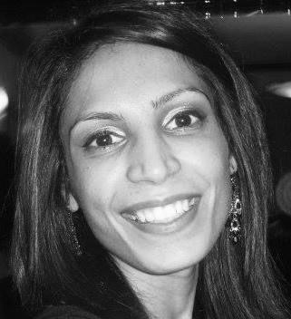
Next steps
Next week
6-month checkpoint (set date now)
Full year checkpoint
Year 3
We will send over your Year 2 Climate Action Plan and guidance on getting started.
We encourage you to share this with governors/ students/ wider community
Review actions and create your year 3 action plan.
We will ensure you are fully equipped to lead from here.
Check-in on progress and review actions
We encourage you to update us on progress and your plans to complete your plan
Re-run Count Your Carbon calculation
We will ensure you can take the lead on this
Contact your Climate Action Advisor anytime with questions or updates of your progress.
Kumari.kher@letsgozero.org
www.letsgozero.org
charity no: 1104153

