Slide 1


Supporting Children with AI: A quick briefing for parents
This will be made available as a page on the website shortly.
Notes:
---

Slide 2
Introduction
Notes:
---
This slide references information from the following file: https://eu-prod.asyncgw.teams.microsoft.com/v1/objects/0-suk-d1-4fb81f9af94a2d28849a618c3dde87a6/views/original/Supporting_Children_with_AI_Presentation.pptx
Understanding AI in Children's Lives

Slide 3
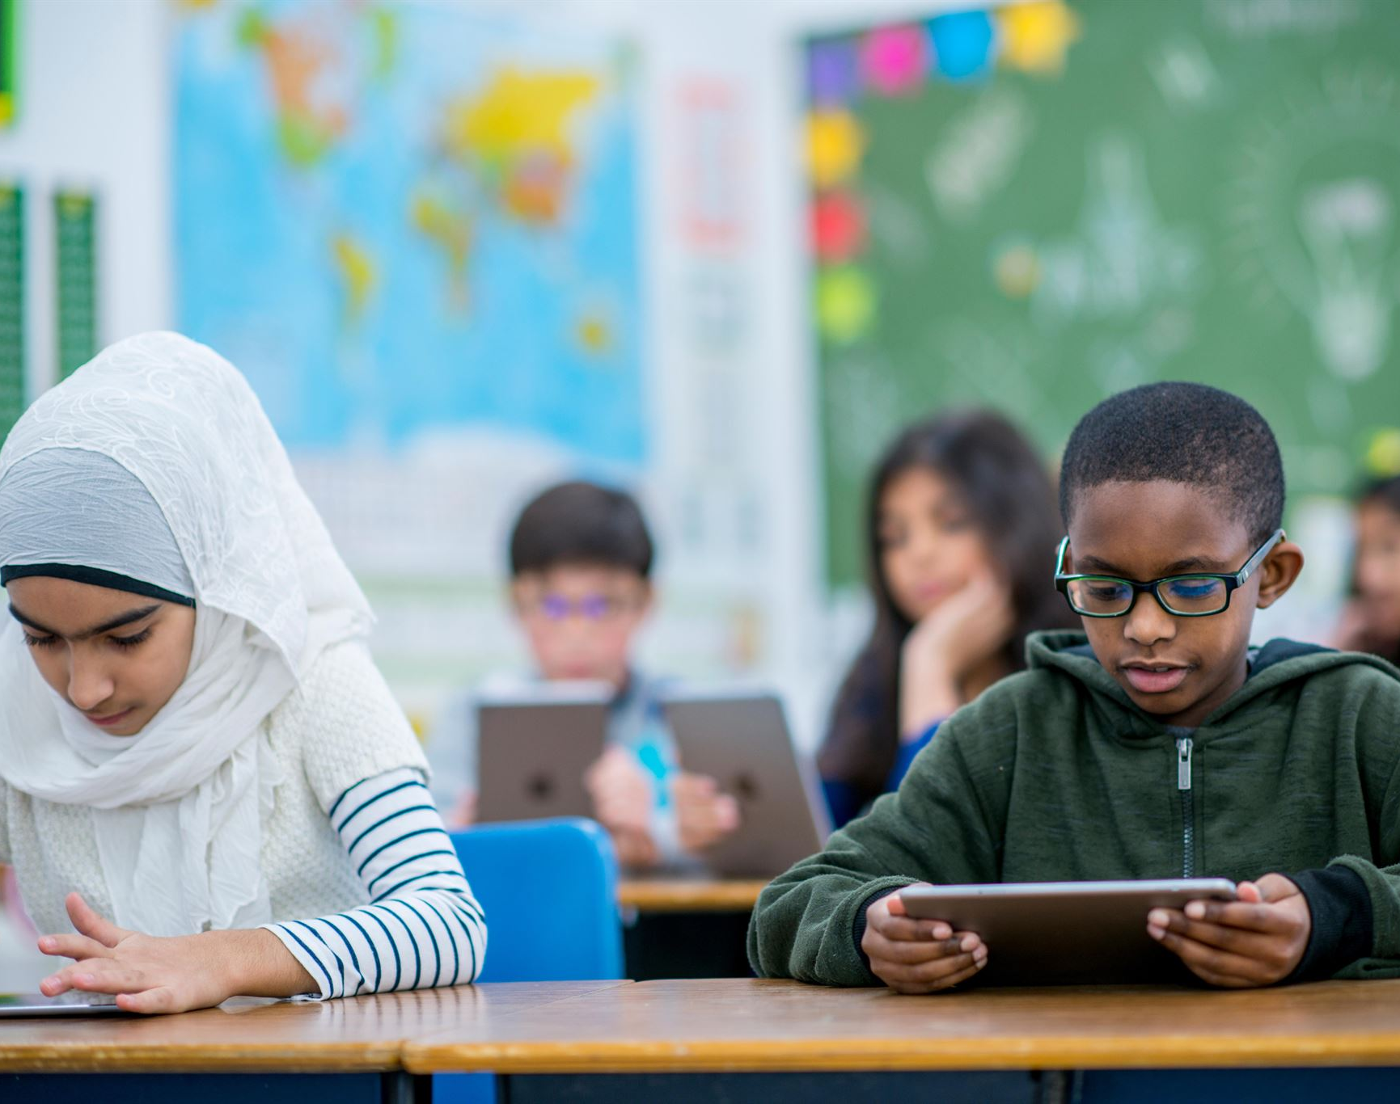
Understanding AI in Children's Lives
AI's Role in Daily Life
  AI is increasingly integrated into children's everyday interactions through devices and search engines.
Benefits of AI for Children
  AI provides educational tools and entertainment that enhance learning experiences for young users.
Risks and Challenges
  AI can unintentionally expose children to inaccurate or inappropriate information requiring careful guidance.
Need for Proactive Approach
  Educators and caregivers must help children navigate AI safely and responsibly in daily life.
Notes:
---
This slide references information from the following file: https://eu-prod.asyncgw.teams.microsoft.com/v1/objects/0-suk-d1-4fb81f9af94a2d28849a618c3dde87a6/views/original/Supporting_Children_with_AI_Presentation.pptx
At Oak Cottage School, we recognize both the benefits and risks that artificial intelligence (AI) brings to education, work, and our broader community. AI is rapidly becoming an integral part of daily life, especially for children and young people. It often serves as the first point of interaction on search engines like Google and Bing, and is embedded in various devices such as smart speakers, tablets, and smart TVs. These technologies influence children's perceptions of the world around them, often without their full understanding. While AI can offer educational and entertainment value, it also poses risks, particularly when the information it provides is inaccurate or inappropriate. This growing presence of AI necessitates a proactive approach to ensure children are equipped to navigate these technologies safely and responsibly.

Slide 4
Overview of AI Tools
Notes:
---
This slide references information from the following file: https://eu-prod.asyncgw.teams.microsoft.com/v1/objects/0-suk-d1-4fb81f9af94a2d28849a618c3dde87a6/views/original/Supporting_Children_with_AI_Presentation.pptx
Types of AI Content and Tools

Slide 5

Types of AI Content and Tools
AI-Generated Media
  AI tools create or alter images, videos, and voice recordings using online generators for diverse content production.
AI Chatbots
  AI chatbots simulate human-like conversations, responding to messages and often identifying themselves as bots.
AI Content Generators
  These platforms produce new content or edit existing media based on user commands, enhancing creative workflows.
AI Summaries
  AI summaries compile and condense information from various sources, offering quick insights at search results.
Notes:
---
This slide references information from the following file: https://eu-prod.asyncgw.teams.microsoft.com/v1/objects/0-suk-d1-4fb81f9af94a2d28849a618c3dde87a6/views/original/Supporting_Children_with_AI_Presentation.pptx
AI tools encompass a wide range of functionalities that generate or manipulate content. AI-generated content includes images, videos, and voice recordings created using online generators. These can be entirely artificial or modified versions of real content. AI content generators are platforms that produce new content or edit existing media based on user commands. AI chatbots simulate conversations, often responding to short messages and identifying themselves as bots, though they may use human-like names. AI summaries compile and condense information from various sources, typically appearing at the top of search engine results. These summaries aim to provide quick insights, often listing the sources used. Understanding these tools is essential for guiding children in their interactions with AI technologies.

Slide 6
Generative AI Chatbots
Notes:
---
This slide references information from the following file: https://eu-prod.asyncgw.teams.microsoft.com/v1/objects/0-suk-d1-4fb81f9af94a2d28849a618c3dde87a6/views/original/Supporting_Children_with_AI_Presentation.pptx
Functionality and Capabilities

Slide 7
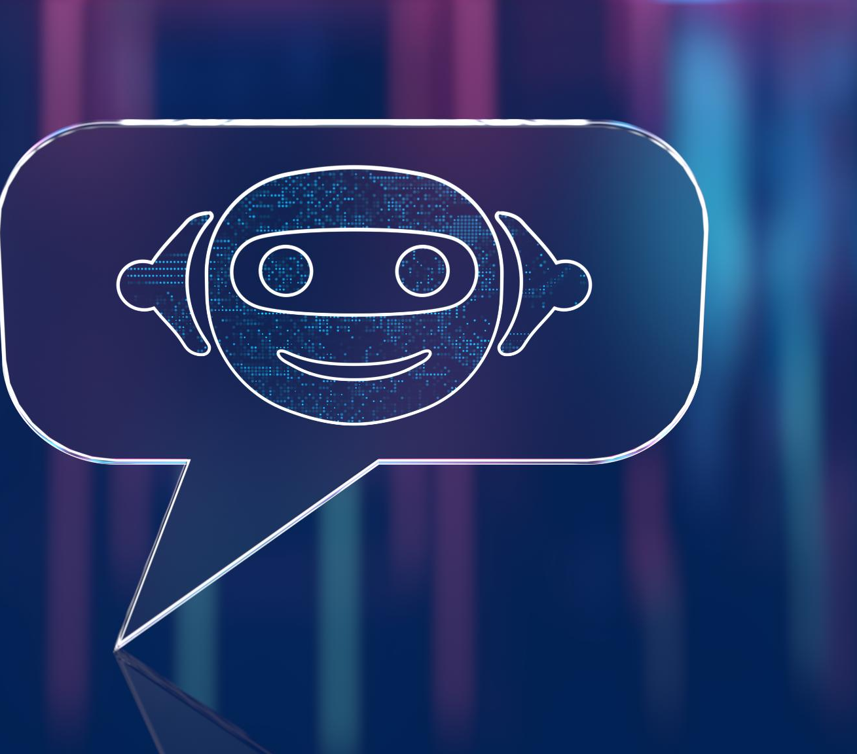
Functionality and Capabilities
Conversational Content Generation
  Generative AI chatbots create original, coherent responses beyond pre-programmed scripts, enabling complex interactions.
Multimodal Processing
  These chatbots process and respond to multiple input types like text, speech, and images for dynamic communication.
Limitations in Understanding
  AI chatbots lack human-like reasoning, judgment, and emotions; their outputs rely on patterns in training data.
Notes:
---
This slide references information from the following file: https://eu-prod.asyncgw.teams.microsoft.com/v1/objects/0-suk-d1-4fb81f9af94a2d28849a618c3dde87a6/views/original/Supporting_Children_with_AI_Presentation.pptx
Generative AI chatbots are advanced tools that analyze natural language and generate responses in a conversational format. Unlike traditional chatbots that rely on pre-programmed responses, generative AI chatbots create original, coherent, and complex content. They are increasingly multimodal, meaning they can process and respond to text, speech, and images. These chatbots are capable of producing realistic images and art, responding to spoken prompts, and engaging in dynamic conversations. However, it's important to note that these systems do not possess human-like reasoning, judgment, or emotional understanding. Their responses are based on patterns in training data, and they lack an inherent sense of truth or morality. This distinction is crucial when evaluating the reliability and appropriateness of their outputs.

Slide 8
Technologies Behind Generative AI
Notes:
---
This slide references information from the following file: https://eu-prod.asyncgw.teams.microsoft.com/v1/objects/0-suk-d1-4fb81f9af94a2d28849a618c3dde87a6/views/original/Supporting_Children_with_AI_Presentation.pptx
Text, Image, and Speech Generation

Slide 9
Text, Image, and Speech Generation
Text Generation with LLMs
Large language models predict the most likely next words based on extensive training data in a manner similar to advanced auto-complete.
Image Generation via Diffusion
Diffusion models add noise to data then reverse the process to create detailed and realistic new images.
Speech Recognition Technology
Speech recognition converts spoken language into text by audio analysis and algorithmic prediction, enabling chatbot understanding.
Notes:
---
This slide references information from the following file: https://eu-prod.asyncgw.teams.microsoft.com/v1/objects/0-suk-d1-4fb81f9af94a2d28849a618c3dde87a6/views/original/Supporting_Children_with_AI_Presentation.pptx
Generative AI technologies operate across multiple modes, each powered by distinct mechanisms. Text generation is driven by large language models (LLMs), which predict the most likely next words based on vast training data. This process resembles an advanced auto-complete system. Image generation utilizes diffusion models, which simulate the natural dispersion of particles to create detailed and realistic visuals. These models begin by adding noise to training data and then reverse the process to generate new images. Speech recognition enables chatbots to understand spoken language by converting audio into text through sound analysis and algorithmic prediction. This differs from voice recognition, which identifies individual voices. These technologies collectively enable AI systems to interact in diverse and sophisticated ways.

Slide 10
Applications and Risks
Notes:
---
This slide references information from the following file: https://eu-prod.asyncgw.teams.microsoft.com/v1/objects/0-suk-d1-4fb81f9af94a2d28849a618c3dde87a6/views/original/Supporting_Children_with_AI_Presentation.pptx
Best Uses and Potential Dangers

Slide 11

Best Uses and Potential Dangers
Creative Applications
  Generative AI supports creative tasks like idea generation, writing, and content revision effectively.
Misleading Information Risks
  AI chatbots can produce plausible but incorrect or misleading information, posing trust challenges.
Bias and Harmful Outputs
  Training data biases can cause AI to reflect toxic or harmful stereotypes and misinformation.
Need for Responsible Use
  Critical evaluation and responsible AI use are essential to mitigate risks and ensure safety.
Notes:
---
This slide references information from the following file: https://eu-prod.asyncgw.teams.microsoft.com/v1/objects/0-suk-d1-4fb81f9af94a2d28849a618c3dde87a6/views/original/Supporting_Children_with_AI_Presentation.pptx
Generative AI excels in creative and fictional contexts, offering support for idea generation, writing, and content revision. It can simulate conversations, draft essays, and provide summaries based on reliable data. However, these capabilities come with significant risks. The hype surrounding AI can lead to unrealistic expectations and misplaced trust, especially when used in high-stakes environments. AI chatbots, while often accurate, can produce misleading or incorrect information that sounds plausible. Efforts to filter harmful content vary across providers and are not foolproof. Training data may include biased or toxic material, which can be reflected in AI outputs. Additionally, AI systems may reinforce misinformation, disinformation, and harmful stereotypes, posing risks to impressionable users. These challenges highlight the need for critical evaluation and responsible use.

Slide 12
Parental Guidance
Notes:
---
This slide references information from the following file: https://eu-prod.asyncgw.teams.microsoft.com/v1/objects/0-suk-d1-4fb81f9af94a2d28849a618c3dde87a6/views/original/Supporting_Children_with_AI_Presentation.pptx
Tips for Supporting Children

Slide 13
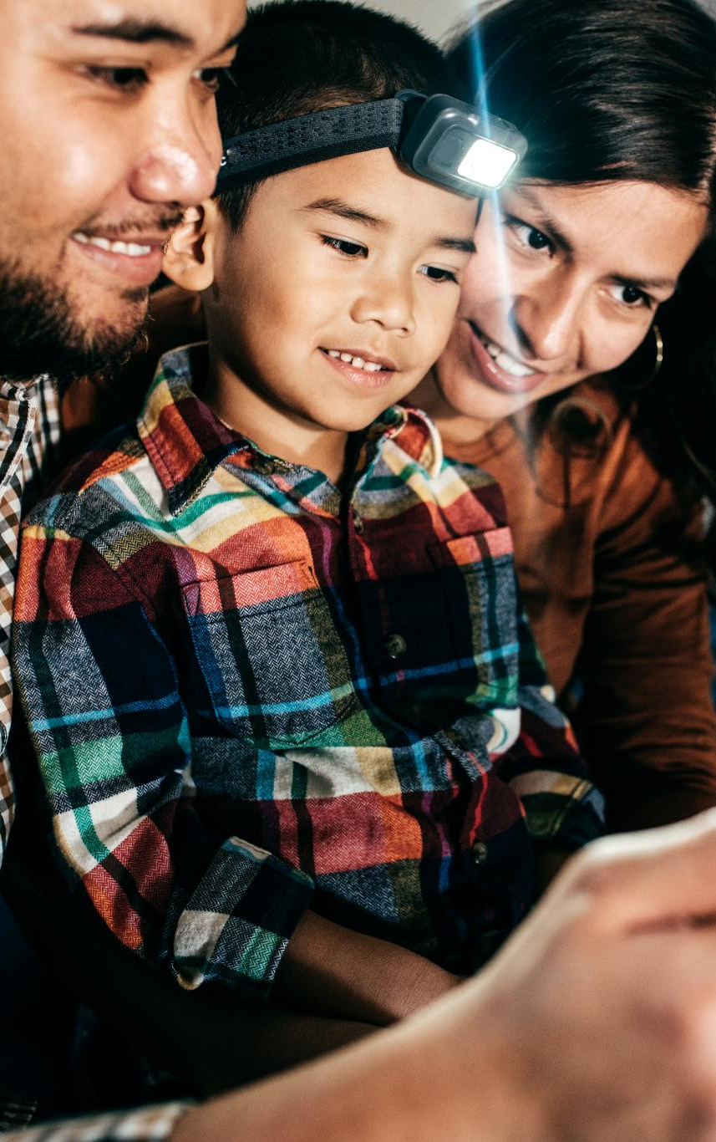
Tips for Supporting Children
Open AI Conversations
  Engage children in discussions about AI tools and content, sharing benefits and risks openly.
Awareness of AI Content
  Teach children that AI content may be altered or unrealistic and not everything online is true.
Reporting Harmful Content
  Guide children on how to recognize and report harmful or inappropriate AI-generated content.
Reliable Information
  Encourage verification of sources for AI-generated summaries and emphasize trustworthy information.
Notes:
---
This slide references information from the following file: https://eu-prod.asyncgw.teams.microsoft.com/v1/objects/0-suk-d1-4fb81f9af94a2d28849a618c3dde87a6/views/original/Supporting_Children_with_AI_Presentation.pptx
Parents play a vital role in helping children navigate AI safely. Six key tips can guide this support. First, engage in open conversations about where children encounter AI tools and content online, discussing both benefits and risks. Second, remind children that not everything online is real; AI-generated content may appear perfect or altered in subtle ways. Third, address the misuse of generative AI to create harmful content, and ensure children know how to report inappropriate behavior. Fourth, encourage checking sources for AI-generated summaries and chat responses, emphasizing the importance of reliable information. Fifth, direct children to safe sources for health and wellbeing advice, such as Childline. Finally, ensure children know they can seek help from trusted adults or support services if they feel worried or unsafe. These strategies foster awareness and resilience in the digital age.

Slide 14
Resources for Parents
Notes:
---
This slide references information from the following file: https://eu-prod.asyncgw.teams.microsoft.com/v1/objects/0-suk-d1-4fb81f9af94a2d28849a618c3dde87a6/views/original/Supporting_Children_with_AI_Presentation.pptx
Helpful Links and Support

Slide 15

Helpful Links and Support
NSPCC Online Safety Guidance
  NSPCC provides tailored guidance on children’s digital activities to promote safe online behavior.
Natterhub Deepfake Insights
  Natterhub offers educational materials on deepfake images and how to discuss them with children.
UK Safer Internet Centre Advice
  UK Safer Internet Centre delivers general online safety advice and reporting tools for parents and carers.
Notes:
---
This slide references information from the following file: https://eu-prod.asyncgw.teams.microsoft.com/v1/objects/0-suk-d1-4fb81f9af94a2d28849a618c3dde87a6/views/original/Supporting_Children_with_AI_Presentation.pptx
Several resources are available to support parents in guiding their children through safe AI use. The NSPCC offers comprehensive online safety guidance tailored to children's digital activities. Natterhub provides insights into deepfake images and how to discuss them with children. The UK Safer Internet Centre delivers general advice on online safety for parents and carers. These platforms offer practical tools, educational materials, and reporting mechanisms to help families navigate the evolving digital landscape. By utilizing these resources, parents can stay informed and proactive in addressing AI-related challenges and ensuring their children's online wellbeing.

